Slide 1
Debugging in Eclipse
By
Suryaprabha K
BFS TEAM

Slide 2
What we do actually?
Usually, while writing a piece of code, we use print statements to understand what is going on in the code.
This method is suitable for smaller and lesser complex codes, it is not the best way to understand where your code is getting stuck.
Debugging:
Debugging is a technique that is used to see the code execute line by line.
While debugging, we can see the execution line by line of the written code and can stop at any line of code.
We can analyze the code, variables, values assigned to those variables where the code stopped execution.

Slide 3
Why Debugging:
It allows software engineers and developers to fix errors in a program before releasing it to the public.
Usually, compiler errors are clearly visible while writing the code in the eclipse.
But run time errors are visible only when we execute the code and while running, if any run time error occurs, the program fails to execute and terminates abruptly.
To find the run time errors, Debugging is used.
To remove bugs, errors in the program which occurs only during specific condition.

Slide 4
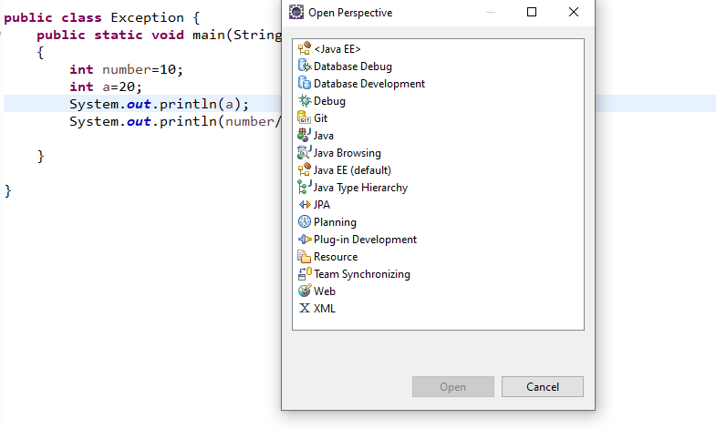
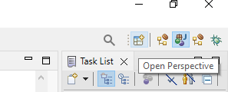
How to Launch Debugger in Eclipse ?
To launch Debugger,
Click on Open Perspective icon -> Select Debug -> Open

Slide 5
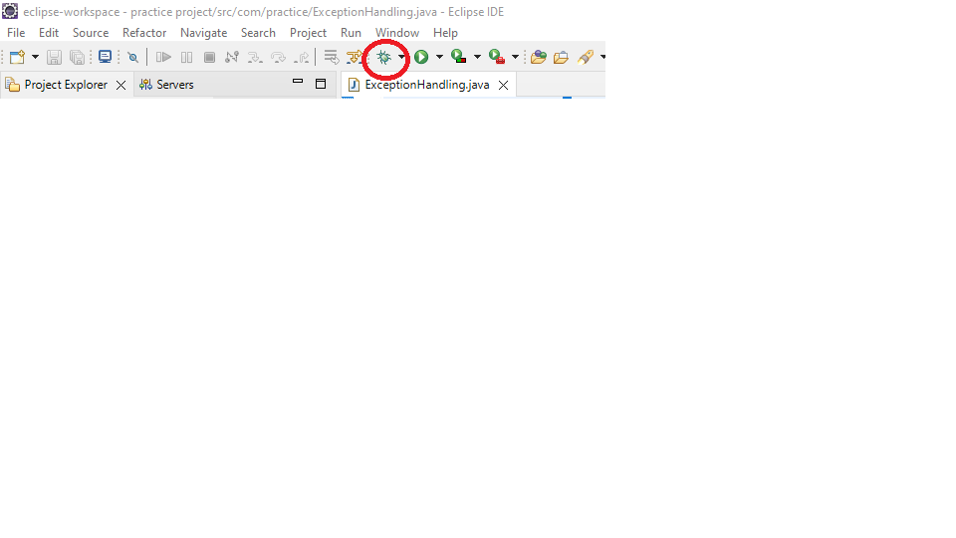
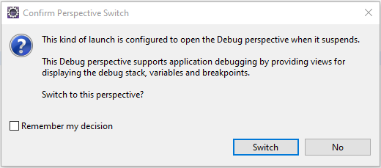
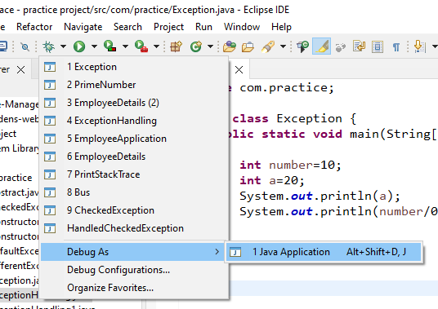
How to Debug Code in Eclipse?
Step:1
Step:3
Step:2

Slide 6
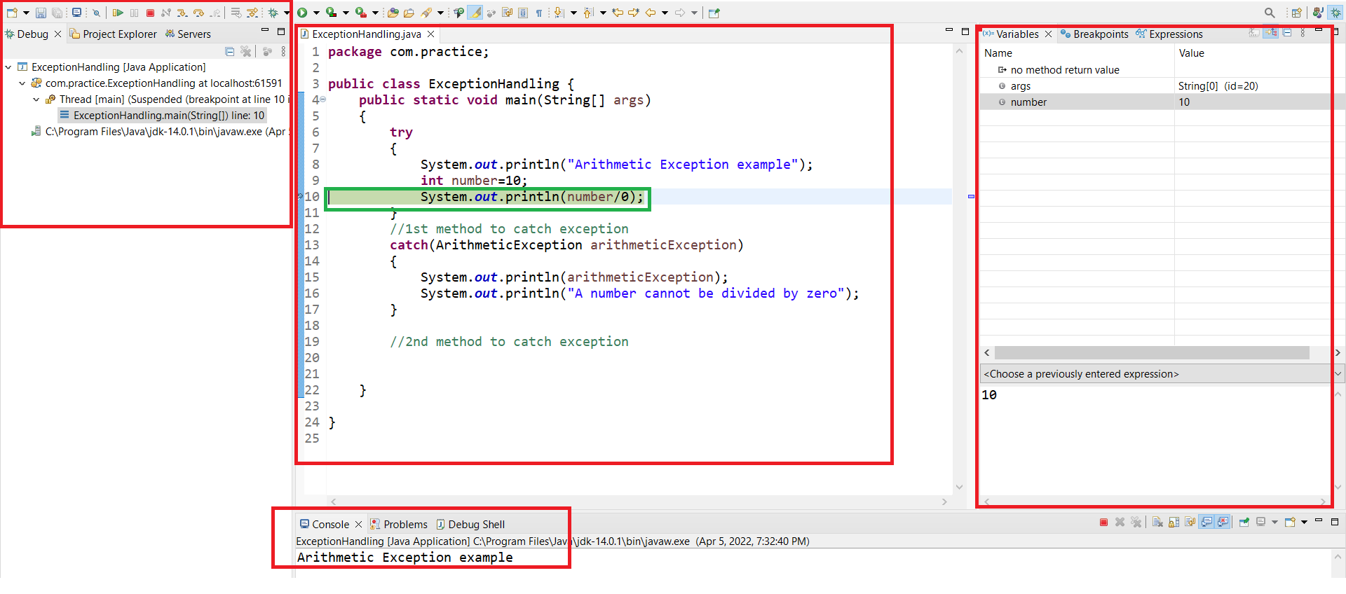
Components in Debug Perspective?
Debug Window, Variables, Console-Debug Shell, Breakpoint, Class, Expressions

Slide 7
Debug Window:
Debug window is present next to the project explorer.
The class which is being debugged is displayed in the debug window.
Breakpoint:
A breakpoint is a point where the execution of the program is halted when the program is in debug mode.
Why Breakpoint?
To take manual control of a program at the time of debugging, we need breakpoint.

Slide 8
How to define a breakpoint?
To define a breakpoint in a piece of code, right click on the left margin of the line in editor and choose Toggle breakpoint.
Breakpoint is also defined by double clicking on the left margin of the line.
Shortcut Key-> Ctrl+Shift+B
When the program execution reaches the breakpoint, the program execution gets halted.
Breakpoints view allows us to delete and deactivate the breakpoints.
All breakpoints can be enabled/disabled using Skip All Breakpoints.

Slide 9
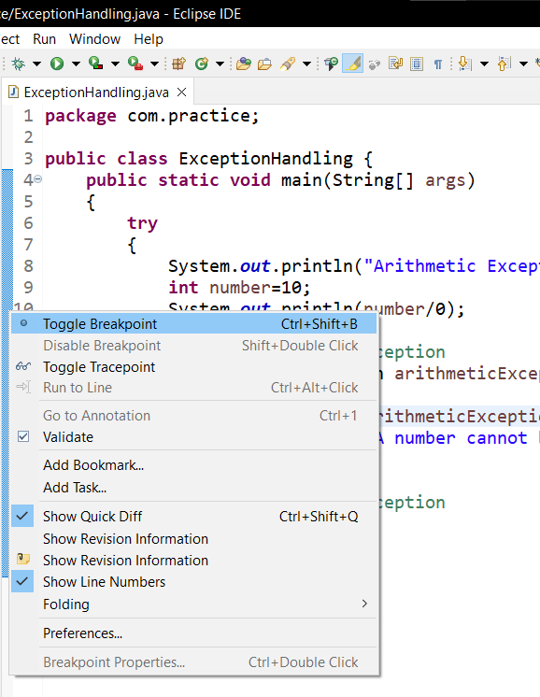
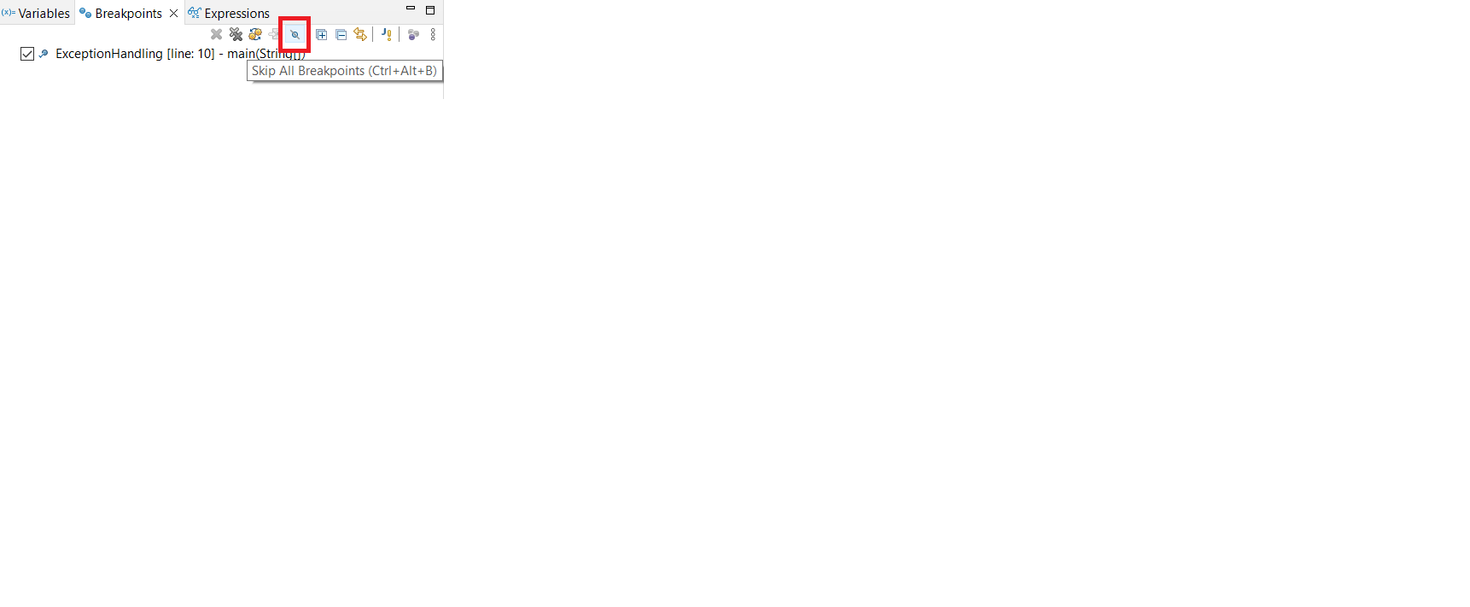
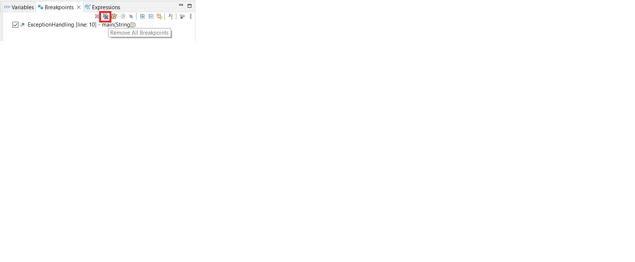


Slide 10
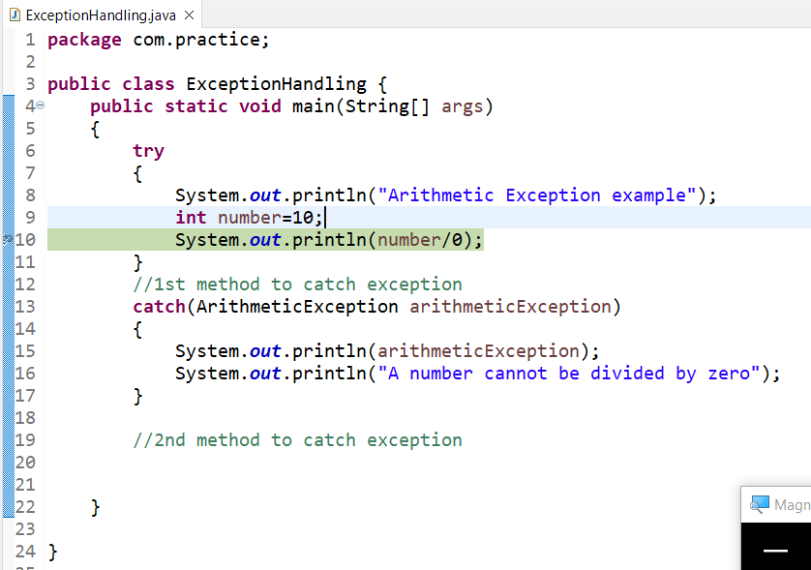
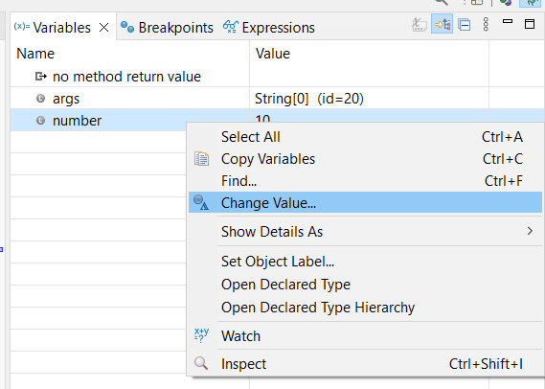
Variables and Expressions:
In this view, the variables can be viewed and how their state is changing during execution can be known.
By right-clicking on the variables displayed here, we can change the value of those variables or view their data type, etc.
Expressions : Allows us to define custom Java expressions to inspect their values.

Slide 11
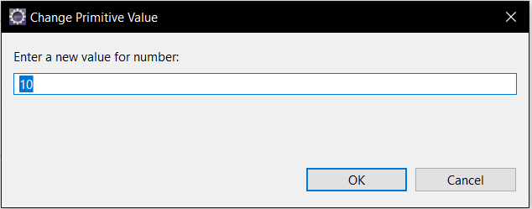
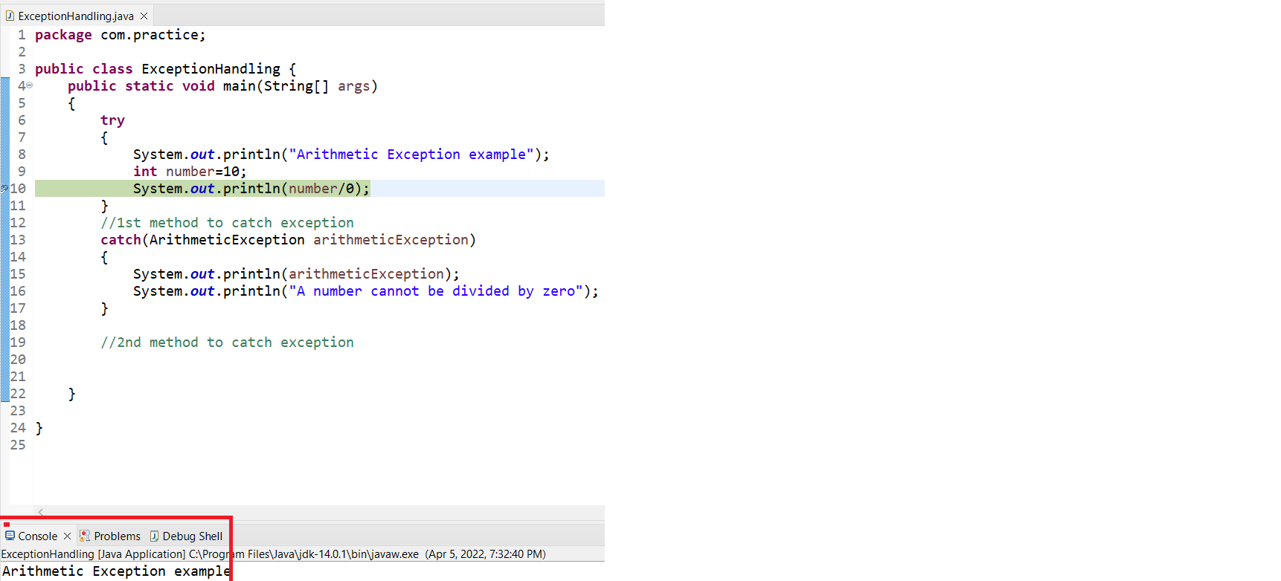
When we select change value, a dialog box opens where we can change the value of the variable.
Console:
This is where we can see the execution happening.
The print statements which gets executed before the breakpoint is displayed in the console.

Slide 12
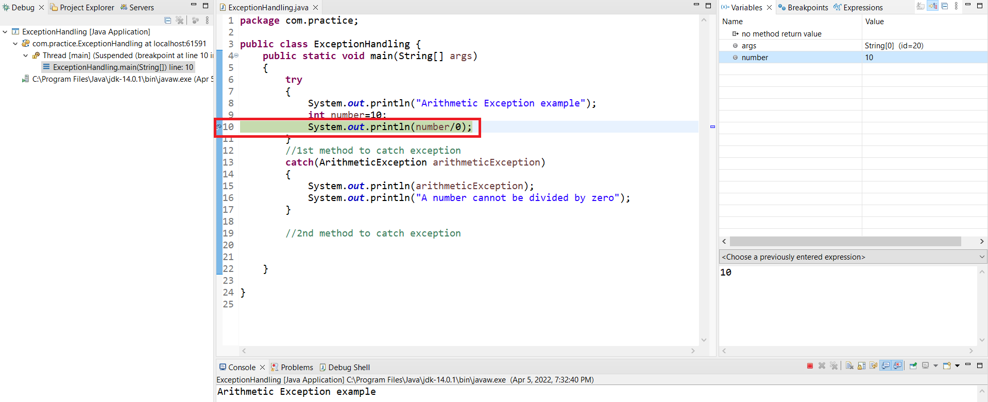
Process:
When we start debugging a particular piece of code, following window will appear.

Slide 13
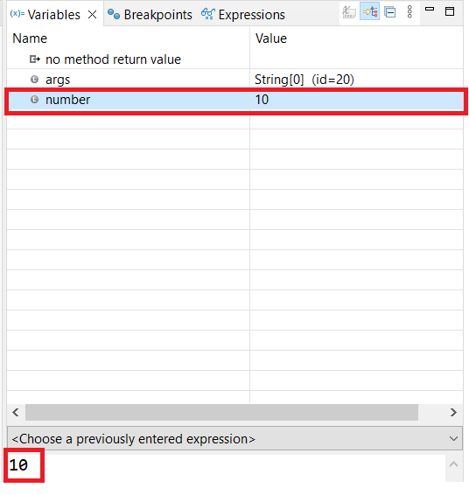
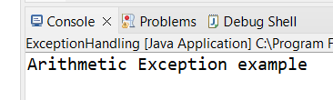
The execution stops at the breakpoint here it is line 10 ->System.out.println(number/0);
The lines of code above break point will be executed and after the breakpoint, the execution stopped.
The variables that is declared above the breakpoint will be displayed in the variables view and when we go for step into or step over the variables will be displayed in the variables view.

Slide 14

To manually enter the main method and analyze, certain steps are to be followed.
Step into-F5
Step over-F6
Step out or Step return-F7
Resume-F8
Suspend
Terminate

Slide 15
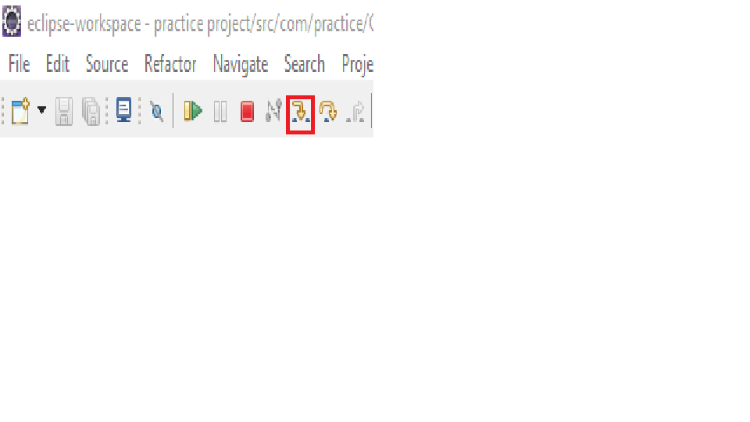
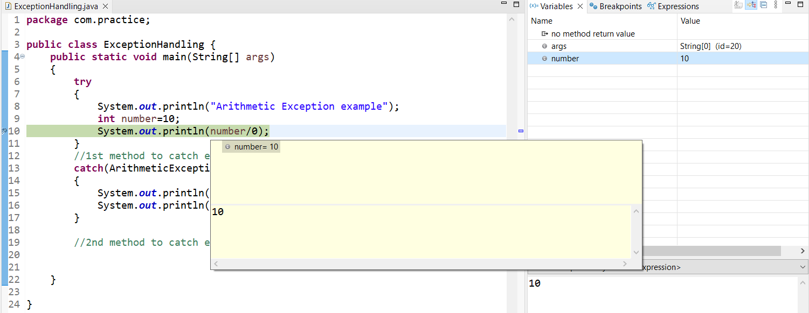
Step into-F5:
Using Step into, we can execute the line of code where the breakpoint is at and move to the next line.
If the current line calls a method, the debugger steps into the method and the execution goes inside the method.

Slide 16
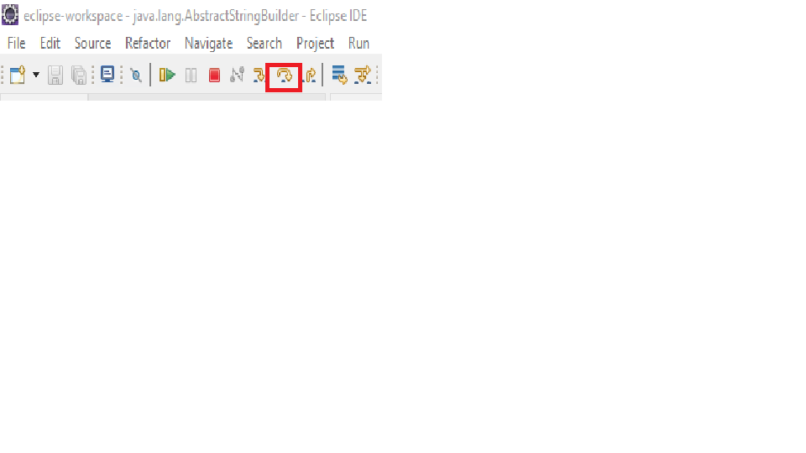
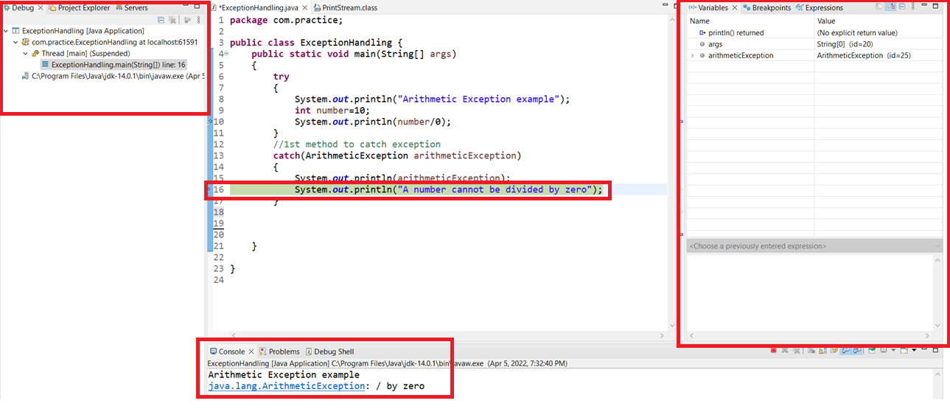
Step over-F6:
Step over does not step into the implementation when there is a function call and moves to next line and execute the code.
In this case, the code will execute normally till you keep hitting step over or F6 and in the end, if there occurs an exception and if we didn’t catch that exception explicitly, we will get the exception info as we get while running the program.

Slide 17
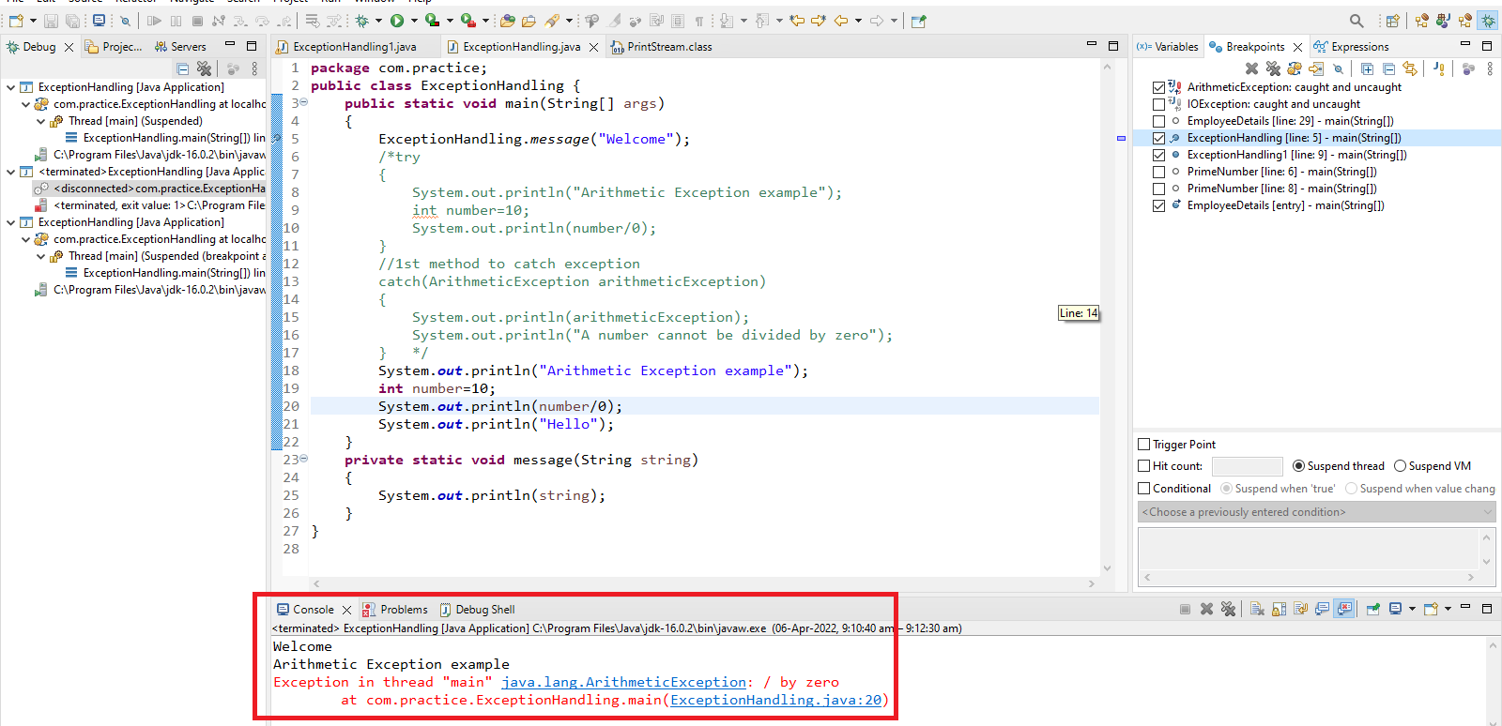

Slide 18
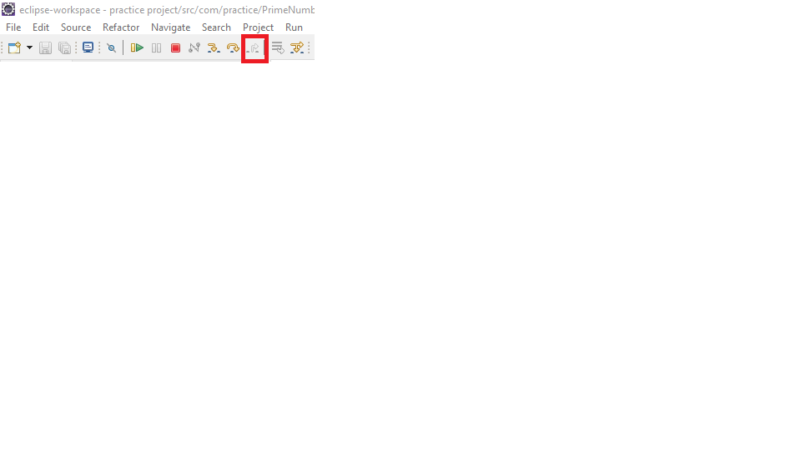
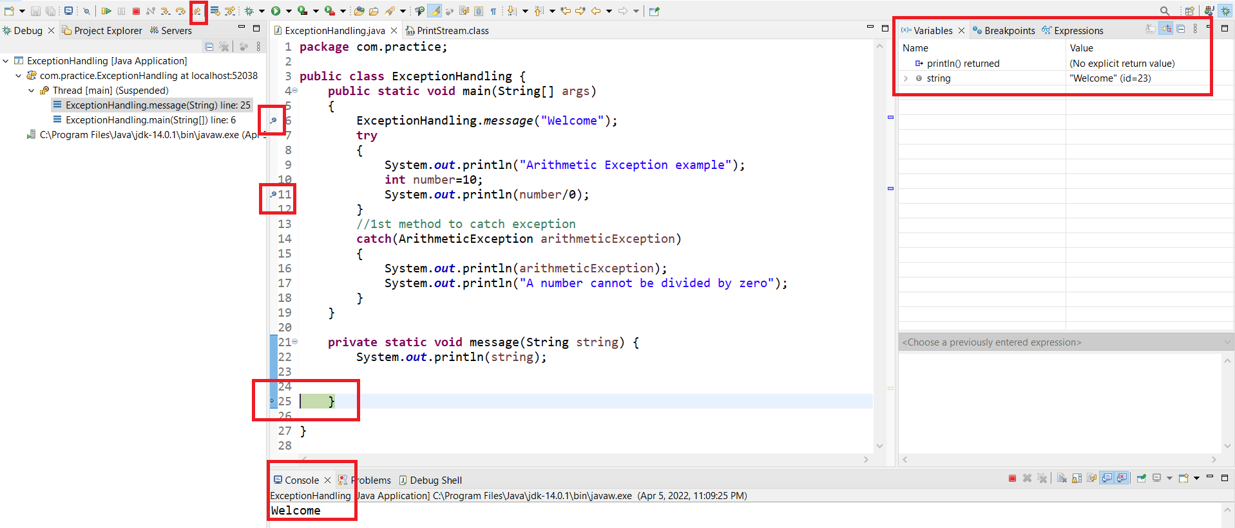
Step out or Step return-F7:
This can be used when your code is in a method and is being called from another place.
This key will finish the execution of the method being debugged and return to the code from where this method is being called.

Slide 19
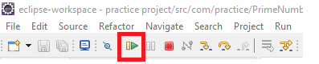
At first, when we give Step into operation, the first breakpoint which is at line 6 the execution goes to the method definition and when we give Step out or return operation, the execution comes out of the method call and moves to next line of code.
The lines of code gets analyzed and executed till the next breakpoint is reached.
Resume-F8:
This option will tell the debugger to continue executing the program until the next breakpoint is reached.
The lines of code between 2 breakpoints is executed without debugging when we press resume operation or F8.

Slide 20
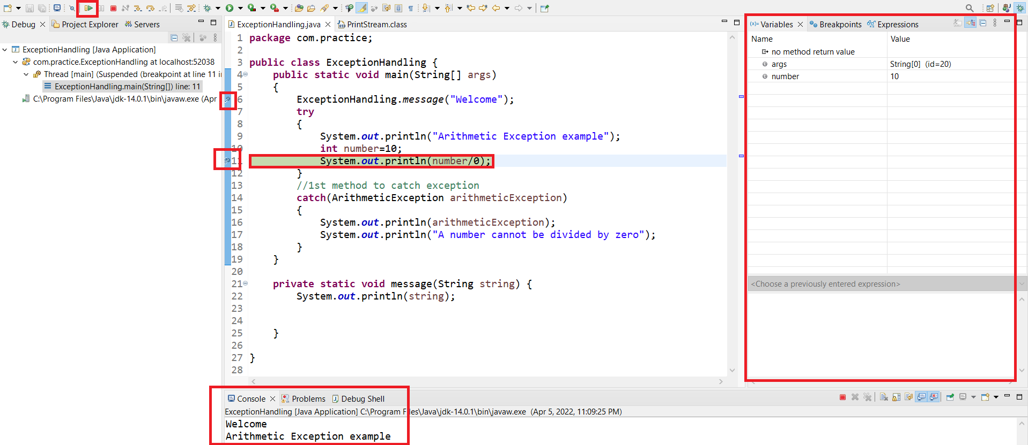

Slide 21
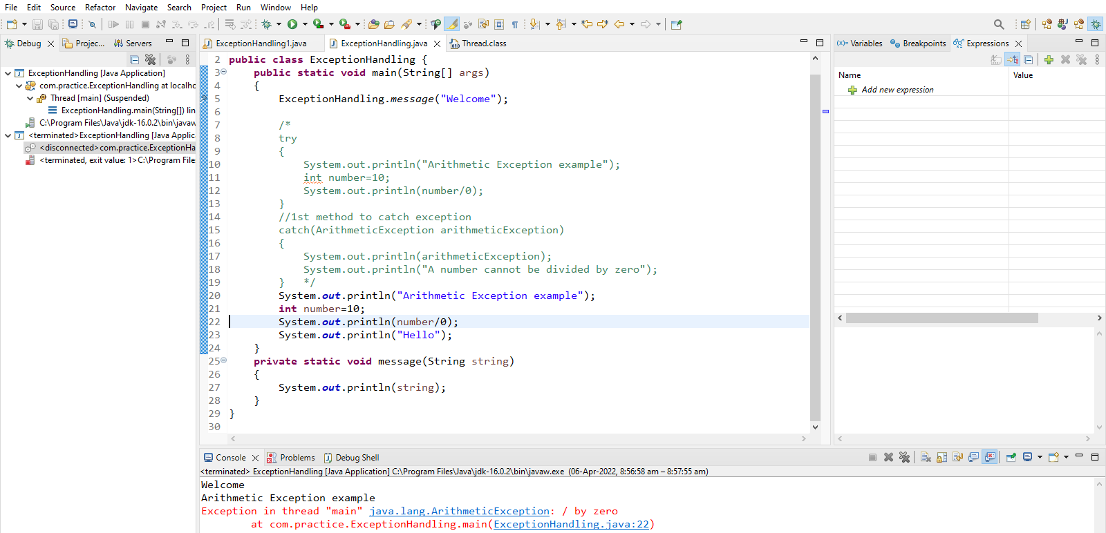
Example: Exception not handled in debugging

Slide 22
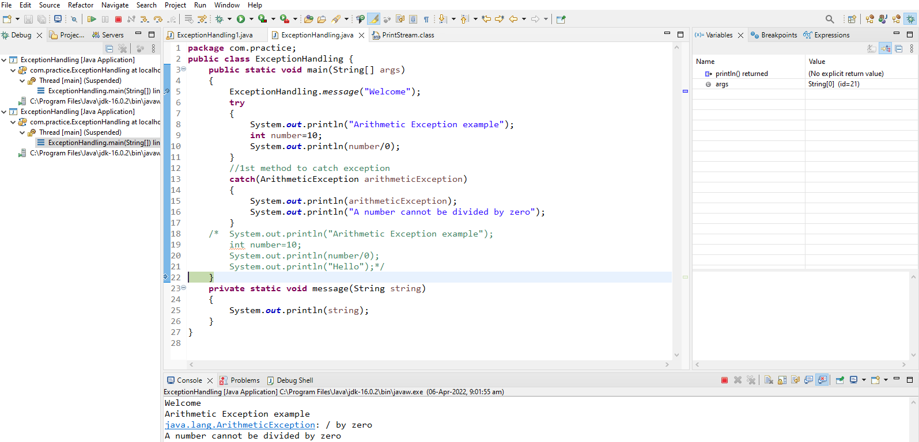
Example: Exception handled in try catch block

Slide 23
Thank you

